Slide 1
NUTRIVISION AI:
A SYSTEMATIC LITERATURE REVIEW
Akshay Joseph
Department of Electronics and Communication Saintgits College of Engineering
Abstract: Unhealthy eating habits and a lack of knowledge about nutrition have become common problems in society. These issues contribute to the rising number of diseases linked to lifestyle choices. Despite having access to food, many people often do not understand the nutritional quality of their daily meals. NutriVision tackles this issue by offering a smart, vision-based nutrition analysis system that assesses food consumption in real time. The system examines meals to give insights into meal balance and dietary gaps. Using Deep Learning models with Python and Pandas for handling nutritional datasets, the system analyses food images to estimate nutritional content through Data Visualisation. This project will uniquely integrates gamification by rewarding for Meal Score, which will depend on factors like Meal Quality Score, Balanced Diet Score, Nutrition Levels and simple Daily/Weekly Challenges. This approach will encourage sustained user engagement and gradual improvement in dietary habits.
INDEX TERMS: food image recognition, deep learning, YOLO, dietary assessment, nutrition estimation, gamification, meal quality scoring, computer vision, precision nutrition
A large part of the problem is not a lack of food but a lack of awareness: most people have little visibility into whether their day-to-day meals are nutritionally balanced, since accurately tracking dietary intake has traditionally relied on self-reported methods such as 24-hour recall or food diaries, both of which are slow, subjective, and prone to recall bias [12].
These limitations have motivated a growing body of research applying computer vision and deep learning to automate dietary assessment directly from food images, removing the burden of manual logging. This review has two complementary aims. First, it summarises the health and behavioural-science background that motivates automated nutrition assessment — the scale of diet-related disease burden, the shortcomings of traditional self-report methods, and existing approaches to scoring meal quality and encouraging behaviour change through gamification. Second, it surveys the state of the art in AI/ML methods for recognising food from images, estimating portion size and nutritional content, and scoring meal healthiness — the building blocks of a system like NutriVision. The review concludes by identifying gaps between existing research and the specific goals of NutriVision, particularly around regional (Indian) cuisine coverage and the integration of gamified engagement with automated nutrition scoring.
I. INTRODUCTION
Diet-related non-communicable diseases (NCDs) — cardiovascular disease, type 2 diabetes, and various cancers
— remain among the leading causes of death worldwide, and unhealthy diet is consistently identified as one of their major modifiable risk factors [1]. Recent global burden-of-disease modeling shows dietary risk continuing to contribute a substantial share of NCD-related deaths and disability-adjusted life years, alongside risk factors like high BMI and elevated blood glucose [2].
II. BACKGROUND: DIETARY HEALTH CHALLENGES AND THE CASE FOR AUTOMATED ASSESSMENT
A. Burden of Diet-Related Disease
Non-communicable diseases driven substantially by dietary risk factors account for a large share of global mortality, with unhealthy diet named as a leading

Slide 2
behavioural risk factor alongside tobacco use and physical inactivity [1]. Global burden-of-disease projections through 2050 continue to attribute a large proportion of cardiovascular and metabolic disease burden to dietary risk, comparable in scale to high BMI and elevated fasting glucose [2]. This scale of impact is a central motivation for tools that make everyday dietary quality visible to individuals rather than something assessed only retrospectively by clinicians.
D. Gamification and Behaviour Change
Because one-off nutrition tracking rarely produces lasting change, several studies have examined gamification as a way to sustain engagement. A gamified mHealth framework built around personalised "missions" targeting key food groups (rather than raw calorie counting) was designed explicitly to avoid the engagement drop-off and disordered-eating risk associated with pure calorie-counting apps [17]. A broader preference study across nutrition-app users found that simple mechanics — goals, progress bars, small rewards — were rated far more positively than more elaborate game elements like avatars or social leaderboards [18], which is a useful design signal for keeping a Meal Score / streak-based challenge system simple and non-gimmicky.
B. Limitations of Traditional Dietary Assessment
The dominant method for assessing what people eat, 24-hour dietary recall, requires participants to recall and estimate portion sizes from memory, which introduces both random error and systematic under-reporting bias, especially for portion size [12]. This has directly motivated vision-based alternatives that estimate what was eaten, and how much, directly from a photograph rather than a subjective report [12], [13].
III. ARTIFICIAL INTELIGENECE AND MACHINE LEARNING FOR FOOD RECOGNITION AND NUTRITION ESTIMATION
C. Meal Quality and Diet Quality Scoring
A. Object Detection with YOLO for Food Items
A separate strand of nutrition research has focused on turning raw nutrient intake into a single interpretable quality score. The Meal Balance Index (MBI) scores a meal from 0–100 based on shortfall and excess nutrients relative to its energy content, and has been validated against national dietary survey data, showing meals from professionally designed menus scoring substantially higher than typical self-reported meals [15]. A related nutrient-based scoring approach has since been validated for other populations using the same shortfall/excess logic [16].
Separately, a system for automatically screening meal images for "healthiness" derived a numeric healthiness score directly from meal photographs and validated it against dietitian rankings and ground-truth nutrition data
[14] — this is conceptually close to what a Meal Quality Score computed from a detected image would need to do. These scoring frameworks give a grounded basis for defining metrics like NutriVision's Meal Quality Score and Balanced Diet Score, rather than inventing an ad hoc formula.
Real meals typically contain multiple food items in one frame, several systems have moved from single-label classification to object detection using the YOLO family, which localises and classifies each item in a single pass. YOLO 11-based systems have been used to detect food items and estimate calories in real time from a single photo [6], and similar YOLO-based pipelines have been built specifically to help users control calorie intake by multiplying a detected food's per-portion calorie value by the number of instances found in the image [7].
Comparative studies of YOLO variants (v5 through v8) for food detection generally report that newer versions offer a better accuracy–speed trade-off for real-time, on-device use [8].
B. Region- and Cuisine Detection: Indian Food
A dataset of 2434 images across 10 Indian food classes was built specifically to address this gap, and a model for image recognition using YOLO 11 on this dataset was created, the model was successfull in detecting the food items uploaded through local web ui (streamlit), further more more data set needs to be created and trained accordingly to create a better image recognition and improved accuracy model.

Slide 3
D.Nutritional Content Estimation
Beyond identifying what food is present, this food detection and nutrition estimation model trained on YOLOv11 integrates computer vision with calorimetric analysis to predict nutritional values. The YOLO backbone rapidly detects food items in an image, classifying them with high accuracy. Once identified, the model maps each food class to a pre‑built nutritional database, estimating parameters like calories, proteins, fats, and carbohydrates. By combining detection with calorimeter‑based energy mapping, the system provides precise nutrition estimation, enabling real‑time dietary monitoring and health tracking.
E. Benchmark Datasets
In order to establish the reliability and robustness of the food detection and nutrition estimation model trained on YOLOv11, a hybrid dataset was constructed by integrating manually labeled food images with the Kaggle -Indian Food Images dataset. This combination ensured diversity in food categories, improved generalization across Indian cuisine, and provided a richer training corpus. To benchmark the dataset, a structured split was performed into training, validation, and test sets, with careful attention to maintaining class balance across both sources. Annotation consistency was verified through manual cross‑checks and labeling tools to minimize discrepancies between the manually curated labels and the Kaggle annotations. Model performance was then evaluated on the test set using standard object detection metrics such as mean Average Precision (mAP), precision, recall, and F1‑score, which provided a quantitative measure of detection accuracy. Beyond detection, the nutritional estimation pipeline was validated by comparing predicted caloric and macronutrient values against calorimeter‑derived ground truth for selected food samples, thereby ensuring that the model’s predictions were not only visually accurate but also nutritionally meaningful. This benchmarking process demonstrated that the integrated dataset was suitable for training a YOLOv11‑based model capable of reliable food recognition and nutrition estimation, while also highlighting the importance of combining diverse data sources to strengthen model generalization.
IV. Discussion: Gaps and Opportunities
Synthesising the health-background and several gaps directly relevant to NutriVision's design.
A.Regional cuisine remains underrepresented
Even with custom created and similar datasets, most published food-recognition benchmarks are still dominated by Western dishes [4], [9], [10], meaning a general-purpose pretrained model is unlikely to recognise dishes like idli, porota, or kerala sadya out of the box — this is the same gap that motivated curating a custom Roboflow dataset for this project rather than relying on an existing model. Asour model
B.Detection-based pipelines are underused for regional food.
Much of the Indian-food literature stops at classification rather than detection [10], while our YOLO-based detection has been shown to outperform classification-only pipelines when multiple food items appear in a single frame [7], [8], [9] — supporting the choice of a YOLO-based detector for NutriVision rather than a plain classifier.
.

Slide 4
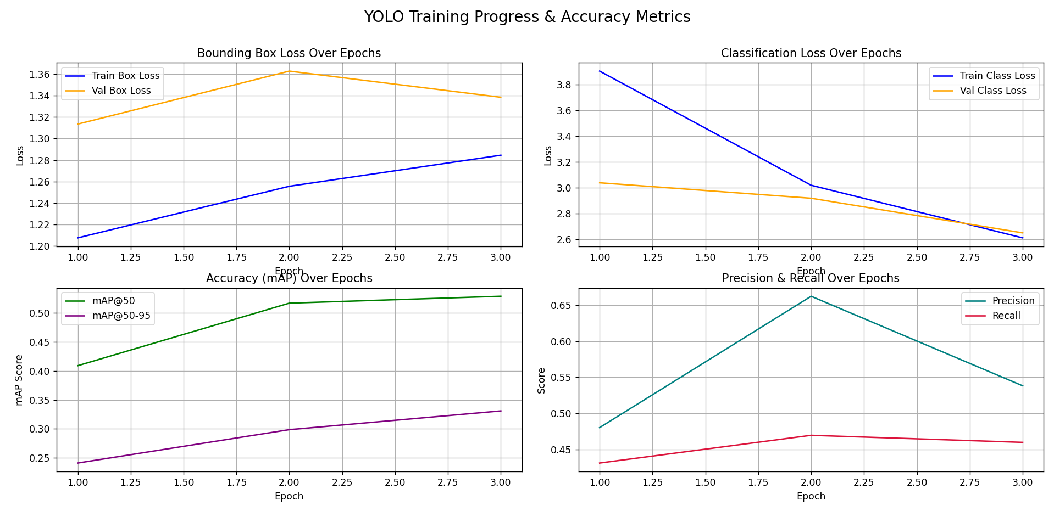
V. PRELIMINARY MODEL EVALUATION AND TRAINING PERFORMANCE
To evaluate the feasibility and initial performance of the custom YOLOv11 architecture for food localization, classification, and subsequent nutritional estimation, the model was subjected to a preliminary training phase over three epochs. The training progress was monitored across core object detection metrics, including localization loss, classification loss, mean Average Precision (mAP), precision, and recall.
A. Loss Convergence Analysis
The training dynamics demonstrate varying behavior between bounding box regression and object classification tasks over the initial epochs:
Bounding Box Regression Loss: The training bounding box loss exhibited a slight upward trend, shifting from approximately 1.21 to 1.28. Concurrently, the validation bounding box loss peaked at epoch 2 (1.36) before showing signs of stabilization at epoch 3 (1.34). This indicates that while the localization head is adapting to the spatial variances of diverse food items, further hyper-parameter tuning and extended training are required to stabilize spatial regressions.
Classification Loss: Conversely, the classification head demonstrated highly favorable convergence characteristics. The training classification loss decreased sharply from 3.90 to 2.60, while the validation classification loss steadily declined from 3.04 to 2.65. This consistent reduction across both sets confirms that the model is effectively learning to differentiate distinct food categories and their corresponding macro-nutritional profiles.
B. Accuracy and Localization Metrics (mAP)
Model accuracy was quantified using standard mean Average Precision metrics at different Intersection over Union (IoU) thresholds:
mAP at 50: The model achieved a steady and robust increase in overall detection accuracy at a relaxed IoU threshold, with mAP@50 rising from 0.41 at epoch 1 to 0.53 by epoch 3.
mAP at 50-95: The stricter metric, mAP@50-95, followed a similar positive trajectory, progressing from 0.24 to 0.33. This continuous upward trend across successive epochs indicates that the network is progressively refining its bounding box tightness and confidence scoring.

Slide 5
C. Precision and Recall Dynamics
The trade-off between localization confidence and retrieval completeness was tracked via Precision and Recall curves:
Precision: Precision peaked at epoch 2, reaching approximately 0.66, before adjusting to 0.54 at epoch 3. This fluctuation suggests temporary variations in false positive generation as the model reconciles bounding box coordinates with complex multi-item food plates.
Recall: Recall demonstrated a steady, gradual improvement, climbing from 0.43 to 0.47 at epoch 2, and concluding at 0.46 by epoch 3. The stability in recall indicates that the model maintains a consistent baseline capability for capturing target food objects within the frame.
VI. CONCLUTION
The current literature confirms that automating dietary assessment is crucial for addressing the global burden of diet-related non-communicable diseases, largely due to the inaccuracies and subjective biases inherent in traditional self-reporting methods. NutriVision presents a robust, automated solution by leveraging the YOLOv11 architecture to simultaneously detect multiple food items, map them to a nutritional database, and estimate their caloric and macro-nutrient values in real time.
Crucially, this system directly addresses significant gaps in existing research by prioritizing underrepresented regional Indian cuisines and utilizing advanced object detection rather than basic image classification. Furthermore, by moving beyond pure calorie counting and integrating scientifically grounded gamification elements—such as the Meal Quality Score and Balanced Diet Score—NutriVision offers a sustainable framework designed to encourage long-term behavioral changes and continuous user engagement.
Preliminary evaluations across initial training epochs validate the system's architectural viability. The model has demonstrated highly favorable convergence characteristics in classification loss and a steady upward trajectory in mean Average Precision (mAP) metrics.
Moving forward, the focus will shift to extended training and targeted hyper-parameter tuning to further stabilize bounding box regressions and optimize spatial localization
REFERENCE
Real-Time Image-based Calorie Estimation using YOLOv4 Object Detection" (2024)
F. Romadhon et al., "Food Image Detection System and Calorie Content Estimation Using YOLO..." (2023)
M. K. Gaikwad, "Food Object Detection Using YOLO Model" (2024)
C. Liu et al., "DeepFood: Deep Learning-Based Food Image Recognition..." (2016)
"Deep Learning in Food Image Recognition: A Comprehensive Review" (2025)
"Deep Learning for Food Image Recognition and Nutrition Analysis..." (2023)
"IndianFoodNet: Detecting Indian Food Items Using Deep Learning" (2023)
G. Vinod and J. He, "Food Portion Estimation via 3D Object Scaling" (2024)
"Machine Learning–Based Screening of Healthy Meals From Image Analysis..." (2020)

